Slide 1
Simulation of Obstacle Avoidance using MPC
Samarth Kalluraya
Shubharanshu Mahapatra

Slide 2
Problem Statement
There in a unstructured environment with moving obstacles. All the passages are known. The cart has to find a path to goal and then navigate through the obstacles.
Assumption:
The cart knows the map of the environment
The cart doesn’t know the obstacles moving inside the environment.

Slide 3
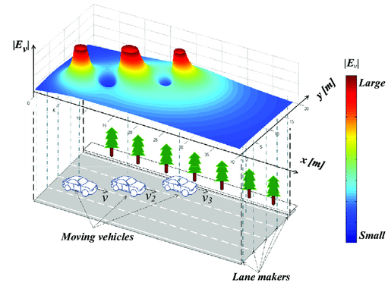
Local Path Planner- Potential Field
Field Choices
Repulsive Field - Exponential so that only nearby objects have effect to simulate real world condition.
Attractive Field is a linear increasing.
[Potential field can be gaussian, square, exponential, linear]
Equations:
Pf_{repulsive} = Re^{-(||x-xnot||)}
2. Pf_{attractive} = A||x-x_{goal}||
Issues
Local Minima
Not the shortest Path
Advantages
Less computation
Fast convergence
https://medium.com/@rymshasiddiqui/path-planning-using-potential-field-algorithm-a30ad12bdb08

Slide 4
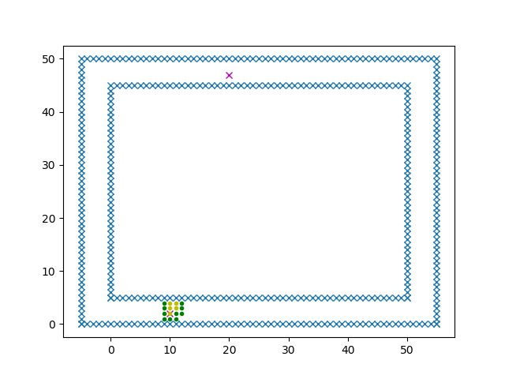
Global Path Planner -A*
Pseudo Code
Closed List/Open List/Parent/Children
Travel Cost/Heuristic Cost/Total Cost
If child in obstacle/child in open cost with lower travel cost - Do nothing
Child not in open list - add child
If child in open list but has lower travel cost is lower - add child/ replace parent for child
Issues
Long Time for Convergence
Computationally intensive
Advantages
Shortest Path Guaranteed -(Not Minimum Time)
No Local Minima Issues

Slide 5
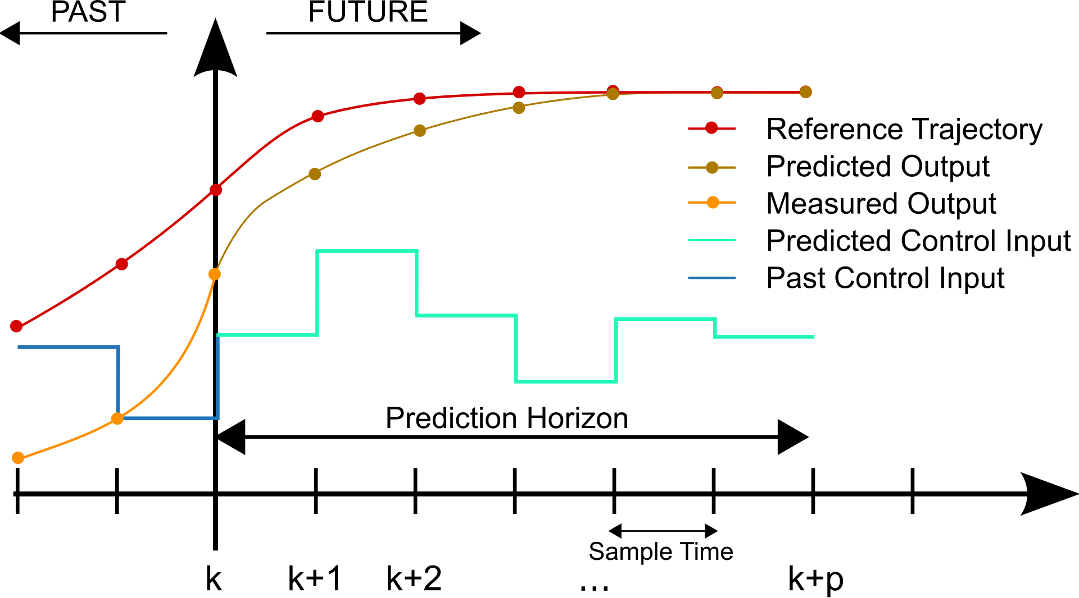
MPC - Very Powerful but Expensive
Why MPC?
Has constraint on input
Works for Nonlinear system
Optimization - Online
Important Concepts:
Receding Horizon
Polytopes and Polyhedrals
Convex Optimization-
Minimize f(x)
Given Constraint Functions
Optimal Control
Source - https://en.wikipedia.org/wiki/Model_predictive_control#/media/File:MPC_scheme_basic.svg
Model Predictive Control- F. Borrelli, C. Jones, M. Morari - Fall Semester 2014 (revised October 2014)
Polytopes - Fedrico Ardillo. http://math.sfsu.edu/federico/Clase/Polytopes/lectures.html
Convex Optimization - Stephen Boyd, Lecture Notes, Stanford

Slide 6
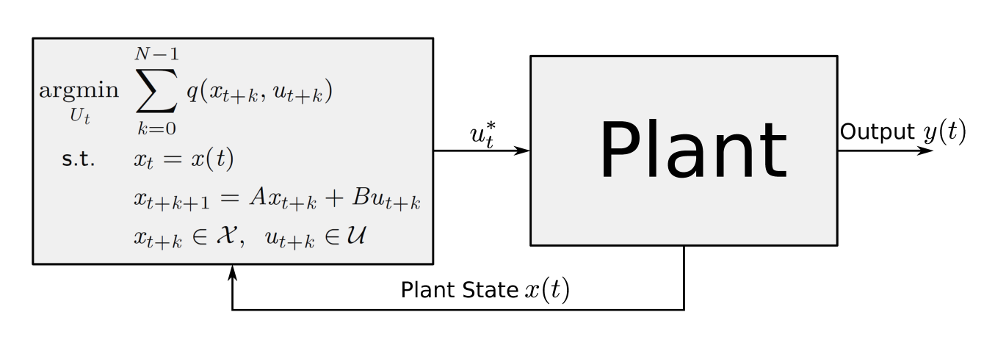
MPC Algorithm
Requires at each time step on-line solution of an optimization problem
Explicit Model Predictive Control
F. Borrelli, C. Jones, M. Morari - Fall Semester 2014 (revised October 2014)

Slide 7
Vehicle Kinematics and Dynamics -MPC Constraints
Max Steering Angle -45 degree
Max Velocity - 15 m/s
Desired Velocity - 5 m/s (Computed iteratively)
Max acceleration - 2 m/s-2
Max Deceleration - 6 m/s-2
Max Steering Rate -30 degree/sec
Wheelbase = 4.5m
Yaw_rate = velocity*tan(steering_angle)/L

Slide 8
System Linearization
A cart in its simplest dynamical system is a nonlinear system.
MPC prefers a linear Model.
So Linearize of the system
State Variable - [x, y, yaw_angle, velocity]
Input Variable - [acceleration, steering_angle]
Linearization and Euler Forward Discretization Process- We linearize the state variables at the current state and states of the horizon and find all the points on the horizon
State_{t+k+1} = State_{t+k} + A’x + B’u + C ( C -is the current state jacobian values)
A’ is the jacobian of States
B’ is the jacobian of inputs.

Slide 9
MPC Cost Function and Stability
Minimize Cost_{error}*(error)² +Cost_{input}*(input)² +Cost_{rate_input}*(rate_of_change_input)²
How to define cost
Cost_error Low - Non Convergence. Cost_error high- Will do whatever it can to follow the path. Unreal inputs
Cost_input Low - Non-feasible inputs, Uncomfortable ride Cost_input high - Repeated overshoot and non following of trajectory.
Cost_rate input Low - Jerky and bumpy ride Cost_rate_input High - Convergence time high and overshooting

Slide 10
Code Structure
MPC Controller - (CVXPY module was used for optimization)
Potential field - Local Planner
A-Star - Global Planner

Slide 11
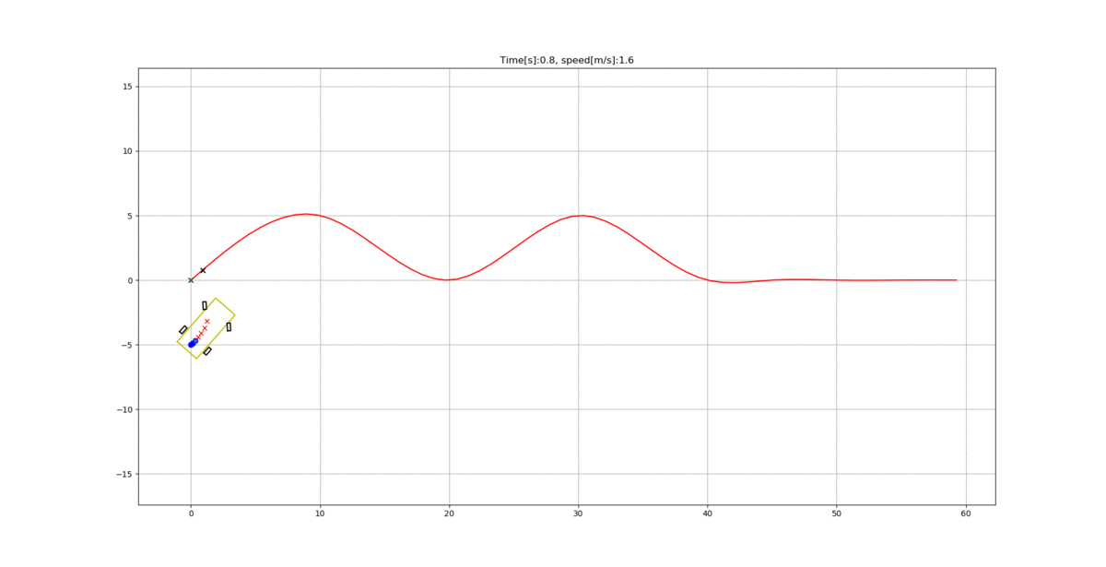
Simulation of path following using MPC

Slide 12
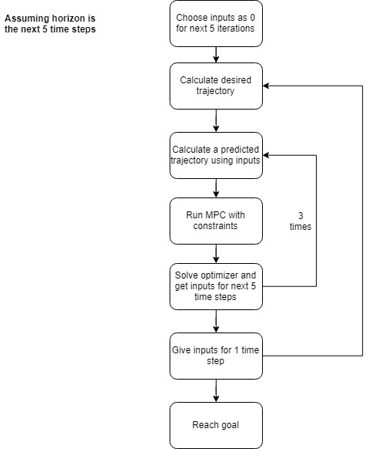
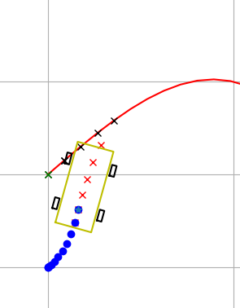
Understanding the controller
Closest point on path - Green cross
Desired trajectory - Black crosses
Car trajectory predicted by MPC - Red crosses

Slide 13
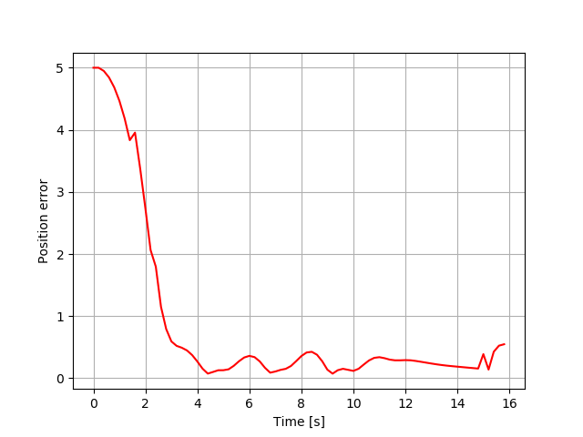
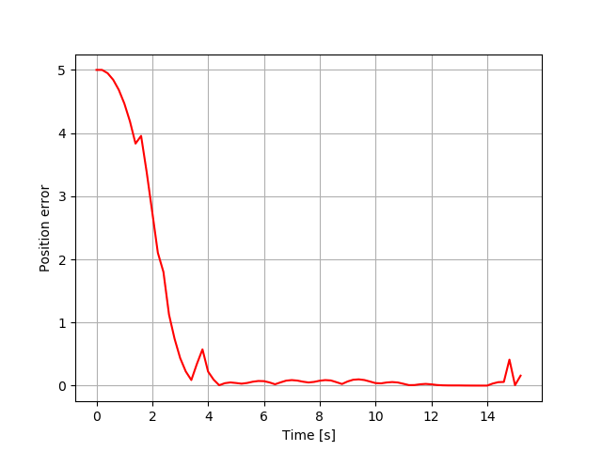
Performance of MPC
Factors affecting performance:
Weights in the cost matrix
Horizon distance
States
Cost equation and Constraints

Slide 14
Simulation of MPC with moving obstacle avoidance
Potential field path planning for some future steps.
MPC ensures the robot follows this path.
Path is updated at every step.

Slide 15
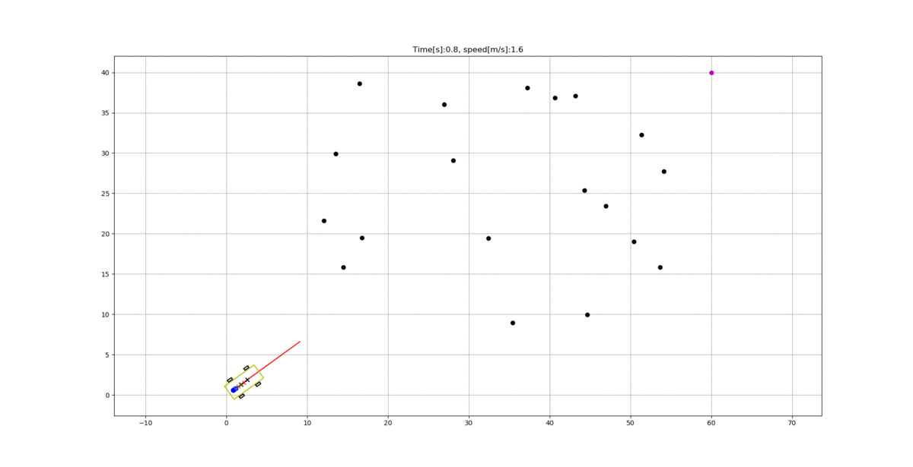
Simulation of MPC with moving obstacle avoidance
Randomly initialized obstacles.
Random velocities imparted to obstacles.

Slide 16
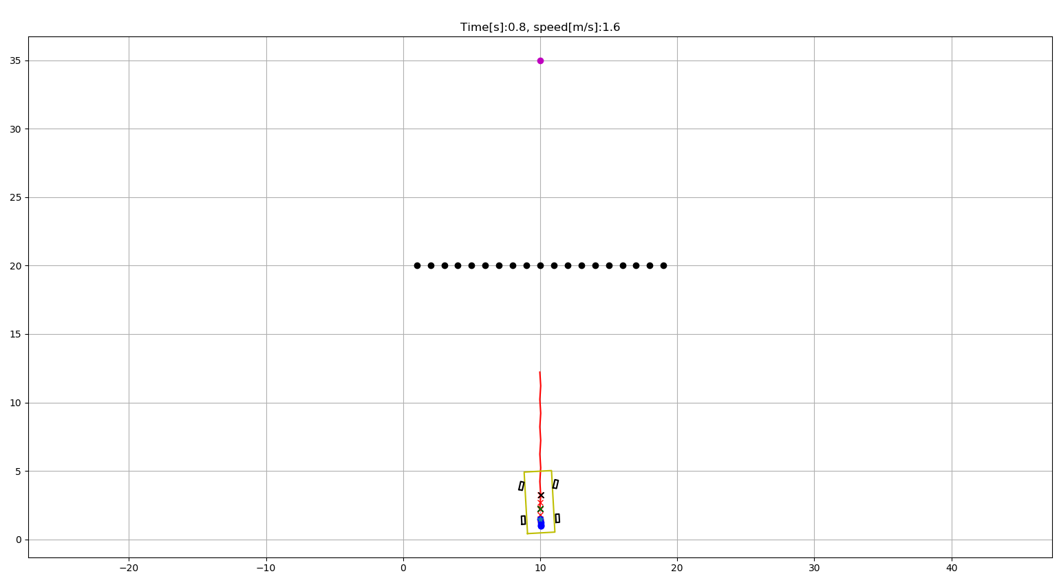
The problem with potential fields?

Slide 17
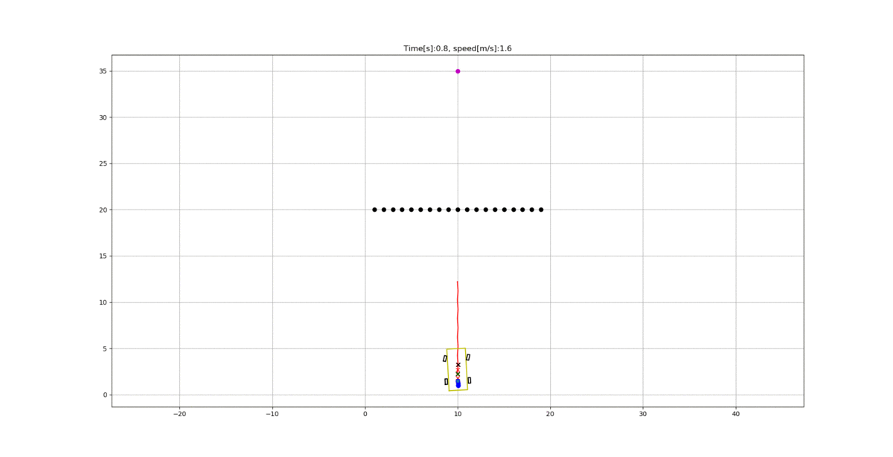
The problem with potential fields?

Slide 18
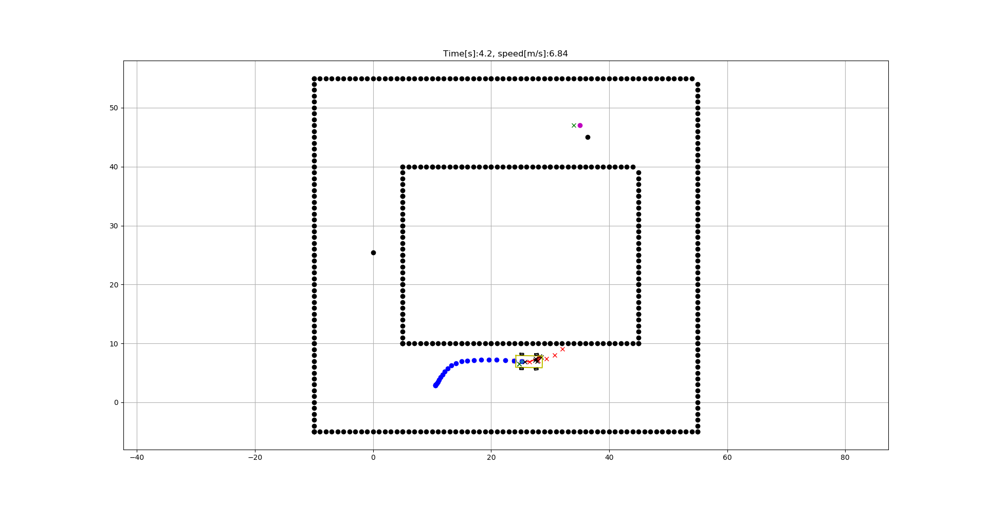
The problem with potential fields?

Slide 19
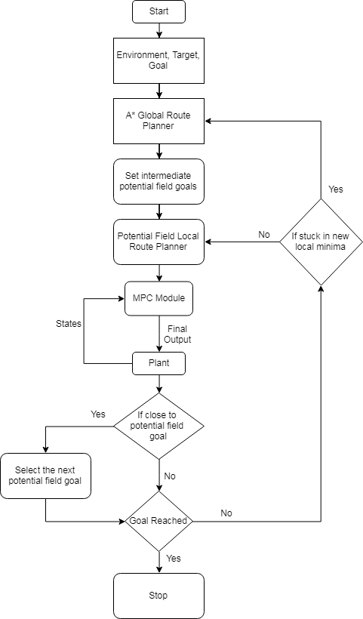
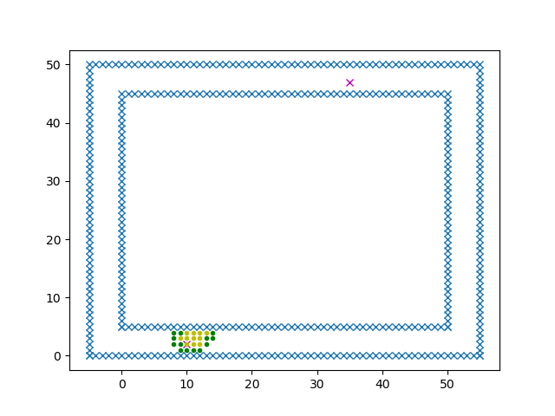
A* planning

Slide 20
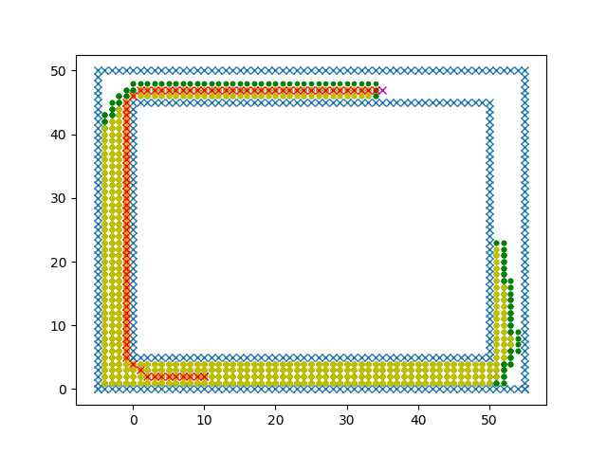

Slide 21
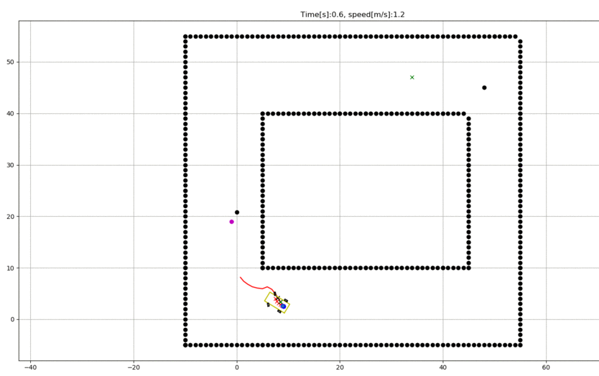
Simulation of MPC on a structured Path with obstacle avoidance

Slide 22
Reference
Cannon, J; Rose, K; Wheeler, R;(2012). Real-Time Motion Planning with Dynamic Obstacles
Yu, S; Li, X; Chen, H; Allgower, F; (2012). Nonlinear Model Predictive Control for Path Following Problems
A star-https://medium.com/@nicholas.w.swift/easy-a-star-pathfinding-7e6689c7f7b2
Potential Field-https://www.cs.cmu.edu/~motionplanning/lecture/Chap4-Potential-Field_howie.pdf
Optimal Path-http://www.mit.edu/~shayegan/files/omidshafiei_optimal_racing_line_control14.pdf
MPC -MPC Lab Notes -F. Borrelli, C. Jones, M. Morari - Fall Semester 2014 (revised October 2014)

Slide 23
Thank You

